Slide 1
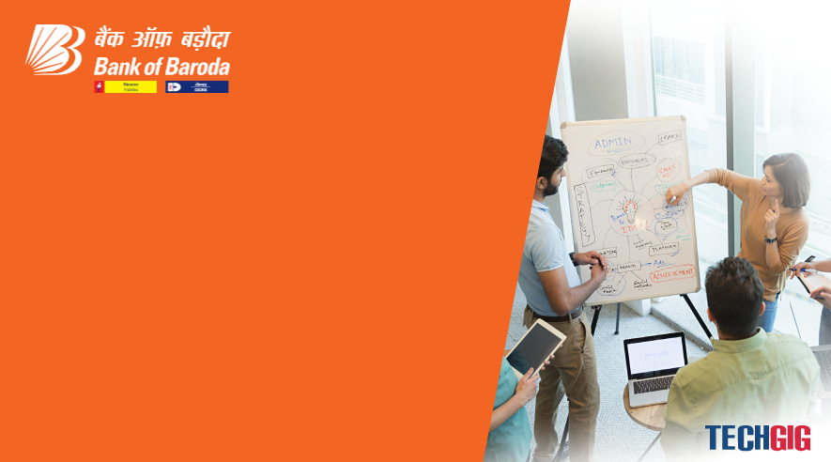

Bank of Baroda Hackathon - 2022
Technology Partner
Your Team Name :
Your team bio : IT Techies
Date : 19-09-2022

Slide 2
Problem Statement?
Why did you decide to solve this Problem statement?
We Decide To Slove This Problem In Accordance To Save Time.
Taking Less Time Is Profitable To The Society And Employees.
Time Is Valuable We Need To Save It.
The Main Reson Is To Reduce Man Power.
Accuracy Is Better Compared To Man Work.

Slide 3
User Segment & Pain Points
Which user /advertiser segment would be early adopter of your product & why?
The most of the teen ages and elders adapt this producut .
The majorty of the peoples are using the Online Authentication to reduce their time .
Our new product help the online Authentication to improve the security features , more user friendly and reduce the time conception .
Our project is mostly help the people how using banking Authentications .

Slide 4
Pre-Requisite
What are the alternatives/competitive products for the problem you are solving?
BARCODE SCANNERS CAN BE USED TO CHECK.
The basic PIN and OTP Authentication are easily hack or guess by the hackers. But our real time authentications are very difficul t to crack by hackers .
We also adding the emergency protocol technology to help the users

Slide 5
Azure tools or resources
Azure tools or resources which are likely to be used by you for the prototype, if your idea gets selected 🡪 We Build our product using c,c++,Python , Flutter , SQl and JavaScript. 🡪 We deploy our codes in Github to easy to access at any time. 🡪 It also support the end-to-end protocol and we add a high level encryption . 🡪 Our product can also support in future banking system.

Slide 6
Any Supporting Functional Documents
Present your solution, talk about methodology, architecture & scalability
We using the scanning machines in our product.
The scanning machines is run by photo scanning technology and live environment scanning .
In other hand the image recognization are run by the frequency checker and word compassion technology .
We add the as image recognization First step of verification and singature check as second step .
If the user in emergency situation it will automatically shutdown the app and sent notification to the bank.

Slide 7
Key Differentiators & Adoption Plan
How is your solution better than alternatives and how do you plan to build adoption?
The basic PIN and OTP Authentication are easily hack or guess by the hackers.
But our real time authentications are very difficult to crack by hackers .
Our product is easy to adopt by the users we using the fast and secure protocol to improve our product .
This products are easily accepted by the smartphone users because it secure and others cannot have idea what they are doing.

Slide 8
GitHub Repository Link & supporting diagrams, screenshots, if any
How far it can go?
Our product is base on the image recoganisation because most of the tech giants are improving their “AI” technology .
So our product is easy to adopt in new future technology.
Github link: https://github.com/Pooja-bts/Pooja-bts

Slide 9
Thank You
Team member names:
Pooja.S
Poornamathi.S
Prathina.A
Sri Harini.R

